Slide 1
WELCOME
Topic : Analog To Analog conversion

Slide 2

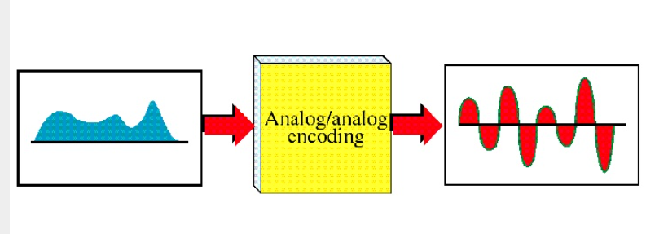
Analog – To – Analog Conversion
* It is a representation of Analog information by an Analog signal.

Slide 3
Analog - To - Analog Conversions
Amplitude Modulation
Frequency Modulation
Phase Modulation
Types of Analog To Analog Conversions

Slide 4
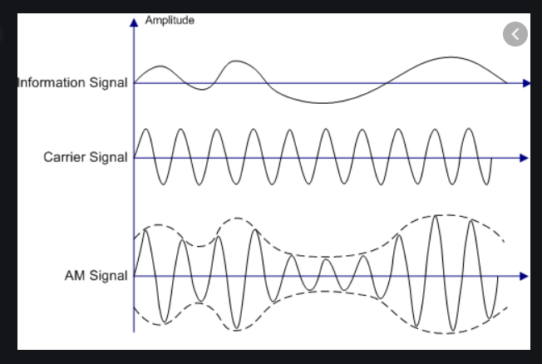
1.Amplitude Modulation
Frequency and phase of carrier or base signal are not altered.
Only the Amplitude changes and we can see that the informationis contained in the envelope of carrier signal.
It can demonstrate that bandwidth of the composite signal is twice that of the highest frequency in information signal that modulates the carrier.
Modulation signal is centred around the carrier frequency and extends the composite signal both ways in equal measure .each of these called sideband

Slide 5
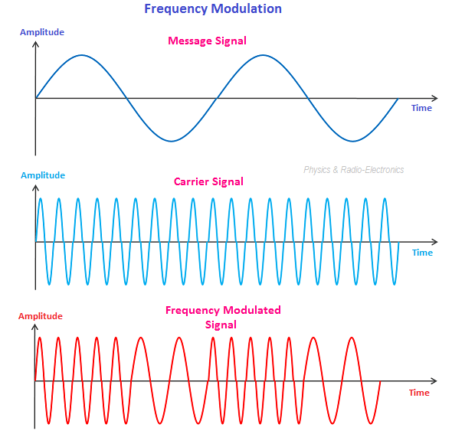
Frequency Modulation
In contrast to amplitude modulation, here it is the frequency of the base signal that depending on the information that is to be sent
The amplitude and phase of the carrier signal are not changed at all.
It can be shown that this results in a bandwidth requirement of 10 times the modulating signal , centred on the carrier frequency.

Slide 6
Phase modulation
The characteristics of this encoding technique are similar to Frequency modulation, and this modulation reduces Complexity of equipment.
In this modulation modulating signal leaves frequency and amplitude of the carrier signal are unchanged but alters the phase

Slide 7
THANK YOU

